Slide 1

Epochs in software and algorithm evolution
András Faragó
Department of Computer Science
The University of Texas at Dallas

Slide 2
Historical Retrospective
Beginnings of computing and networking: the era of hardware
  Core value: hardware
  Software: only secondary, “icing on the cake”
  Example: Arpanet (predecessor of the Internet), 1960s
    Hardware development: ARPA contract with BBN (Bolt, Beranek & Newman, consulting firm in Boston)
    Software development: a large part by enthusiastic graduate students – for free

Slide 3
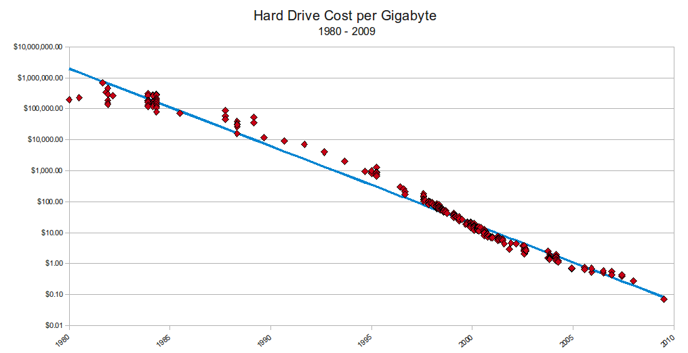
The Era of Software
Hardware is rapidly becoming inexpensive. Example:

Slide 4
The Era of Software
Growing fraction of value belongs to software, hardware cost is shrinking.
But software cannot work without having an algorithm first!
Yet, algorithms are often viewed as merely “icing on the cake”
  Perceived as secondary, just like software was viewed earlier, relative to hardware
  Common perception: algorithms exists only in software. Just like the early view - software is a (small) part of hardware
  Core value is attributed to the implementation, not to the method

Slide 5
Up and Coming: The Era of the Algorithm
Algorithm: tells how a task can be fundamentally carried out (mathematical level, not implementation)
Software: practical implementation
The “era of the algorithm” begins, when:
  The complexity of tasks grows to the level where the key difficulty becomes: how to solve the task at all.
  Once a solution is found, implementation can be done by any skilled programmer.
  → Core value in these cases is not (only) the implementation anymore!

Slide 6
The Era of the Algorithm
- Examples
1. Primality Test
Task: given a (very large) integer N, decide whether it is a prime number or not.
Important application: cryptography.
Requirement: the algorithm should run in time bounded by a polynomial of log N (= bit length of the number N).
First such algorithm: Agrawal, Kayal, and Saxena, 2002 (AKS primality test).
The really hard part: how to solve the algorithmic problem at all, within the required complexity. (It was open since the time of ancient Greece, for well over 2000 years!)
Once the algorithm is given, programming can be done by any skilled programmer.

Slide 7
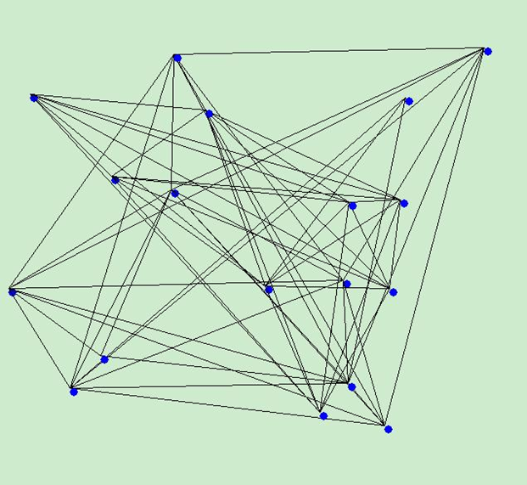
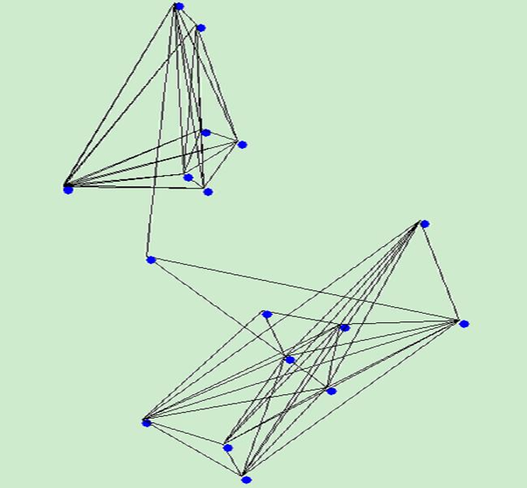
The Era of the Algorithm
- Examples
2. Graph Isomorphism
Task: given two (large) graphs, are they isomorphic?
Isomorphic graphs: they have the same structure, but represented possibly differently.
Example: the two graphs shown are isomorphic, even though they look quite different.

Slide 8
The Era of the Algorithm
- Examples
Graph Isomorphism (continued)
Applications: chemical informatics, data mining, integrated circuit design, network analysis.
Requirement: the algorithm should run in polynomial time in n (= number of nodes).
No such algorithm is currently known, despite about half century of research!
But: it is solvable in quasi-polynomial time. Major recent breakthrough (2015), discovered by Laszlo Babai, Univ. of Chicago.
Quasi-polynomial time: instead of O(n^{c}) it runs in time O(n ^{logc n}).
The really hard part: how to solve the algorithmic problem, and how to prove it is correct (84-page paper!).
Once the algorithm is given, programming can be done by any skilled programmer.

Slide 9
Coming: The Era of Intelligent Algorithms
Traditional algorithm development cycle:
  Design the algorithm
    Includes proving correctness, analyzing complexity
  Implement and test it → turn it into software
  Run it for the task whenever needed, without change.
    Example: whenever a primality test is required, just run the same algorithm.

Slide 10
Intelligent Algorithms
Can learn from “experience” to improve itself
Some practical examples, also showing the attributed monetary value:
  Netflix Prize (2006-2009): 1 million dollar prize for an algorithm that can best predict the customers’ movie preferences, based on their past choices.
  Over 5,000 teams competed.
  Method of winning algorithm: collaborative filtering
    Principle: correlations among past choice patterns tend to result in correlations among future choices
    The algorithm learns from continuously monitoring, updating, and organizing customer choice patterns.

Slide 11
Intelligent Algorithms
Another example:
  Heritage Health Prize (2012-13): 3 million dollar prize for the best algorithm to predict which patients will need hospitalization, and for how long, based on their health history.
  Importance: a good algorithm can save huge amounts in healthcare cost.
  Method of winning algorithm: ensemble prediction
    Ensemble prediction: combine various predictors, and continuously update the combination, based on new observed data.

Slide 12
Intelligent Algorithms
A third example:
  DTRA Algorithm Challenge (DTRA = Defense Threat Reduction Agency): $ 1 million
  Goal: Rapid recognition of pathogens from DNA sequence data, to quickly recognize biological agents that pose a health threat.
  3,000 teams competed
Fourth example: Hutter Prize EUR 50,000
  Goal: best compression of 1GB text from Wikipedia (EUR 500 for each % of compression)
  Importance: compressing data and understanding data are closely related
  Wikipedia is a good representative of human knowledge
  Efficiently compressing it is a big step towards machine understanding human knowledge.

Slide 13
Some Common Features
Combination of two types of knowledge:
  Thorough knowledge of algorithmic techniques
  Expertise about a specific application domain
    Allows to pick the right model, rather than relying only on “blind” (domain independent) machine learning
Requires serious algorithm engineering:
  Fine tuning of (many) parameters via extensive experimentation, possibly with ML algorithms
  Systematic testing to ensure correctness and efficiency

Slide 14


